Slide 1
CLOUD COMPUTING
Subject Code: 21CSE362T
Video Lecture No.1
UNIT -5

Slide 2
Course Outcomes
Identify then types of services for various applications.
Predict the type of security to be applied for various cloud services.
Examine the concept of virtualization and capacity planning.
Recommend the service provider for specific requirement.

Slide 3
UNIT-5 (Topics To Be Covered)
Web Services
Amazon
Microsoft
Google

Slide 4
1. Web Services
A web service is a standardized method for propagating messages between client and server applications on the World Wide Web.
A web service is a software module that aims to accomplish a specific set of tasks. Web services can be found and implemented over a network in cloud computing.
A web service is a set of open protocols and standards that allow data exchange between different applications or systems.
Web services can be used by software programs written in different programming languages and on different platforms to exchange data through computer networks such as the Internet. In the same way, communication on a computer can be inter-processed.

Slide 5
Web Services Component.
SOAP (Simple Object Access Protocol) :-
SOAP stands for "Simple Object Access Protocol". It is a transport-independent messaging protocol. SOAP is built on sending XML data in the form of SOAP messages. A document known as an XML document is attached to each message
UDDI (Universal Description, Search, and Integration):-
UDDI is a standard for specifying, publishing and searching online service providers. It provides a specification that helps in hosting the data through web services. UDDI provides a repository where WSDL files can be hosted so that a client application can search the WSDL file to learn about the various actions provided by the web service.
WSDL (Web Services Description Language):-
The client implementing the web service must be aware of the location of the web service. If a web service cannot be found, it cannot be used. Second, the client application must understand what the web service does to implement the correct web service.

Slide 6
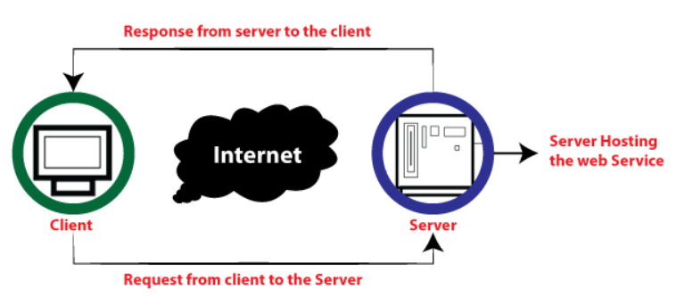
How does web service work?
Remote procedure calls are used to perform these requests. The calls to the methods hosted by the respective web service are known as Remote Procedure Calls (RPC). Example: Flipkart provides a web service that displays the prices of items offered on Flipkart.com. The front end or presentation layer can be written in .NET or Java, but the web service can be communicated using a programming language.

Slide 7
Features of Web Service
XML-based
Loosely coupled
Ability to be synchronous or asynchronous
Coarse Grain
Supports remote procedural calls

Slide 8
Amazon
Amazon Web Services (AWS) is a leading top platform in providing the web services of various domains.
AWS follows the trends of digital IT and comes up needy services with optimized performances covering a wide range of services from Compute to Storage. It covers a wider range of customers of different domains to expand their business operations. T
Popular with startups, enterprises, and government organizations.

Slide 9
Microsoft
Designed by Microsoft in 2010, Microsoft Azure is one of the widely used cloud computing platforms. Azure provides a wide variety of services such as cloud storage, compute services, network services, cognitive services, databases, analytics, and IoT.
It makes building, deploying, and managing applications very easy.
Preferred for enterprise applications and hybrid cloud deployments

Slide 10
Google
It offers a wide range of services, including computing power, storage, databases, machine learning, networking, and more, all delivered over the internet.
GCP enables businesses to build, deploy, and scale applications and services quickly and efficiently without the need to invest in or manage physical infrastructure.
Focuses on data analytics (BigQuery) and innovative solutions

Slide 11
Thank You

